Slide 1



Exploring Coffee Sales Analysis

Slide 2


Introduction
Coffee Sales Analysis: Brewing Insights
Welcome to our presentation on Coffee Sales Analysis, where we delve into the fascinating world of coffee consumption trends using the power of data analytics.
Harnessing the capabilities of Power BI and SQL, we have meticulously analyzed coffee sales data to uncover valuable insights that can drive strategic decision-making within the coffee industry.
In this presentation, we will take you on a journey through the aromatic landscape of coffee sales, exploring market trends, consumer behavior, and sales performance across different regions and product categories.
Join us as we unveil the hidden potential within your coffee sales data and empower you with actionable insights to brew success in the competitive coffee market.

Slide 3




Project Overview
Objective:
The objective of this presentation is to demonstrate how Power BI and SQL were leveraged to conduct a comprehensive analysis of coffee sales data. By combining the analytical capabilities of Power BI with the robust querying power of SQL, we aim to:
Uncover key insights: Explore the intricacies of coffee sales data to identify trends, patterns, and outliers that provide valuable insights into consumer behavior and market dynamics.
Enhance decision-making: Empower stakeholders with actionable information to optimize product offerings, marketing strategies, and operational efficiency in the coffee industry.
Visualize data effectively: Utilize the interactive visualizations and dashboards created in Power BI to present complex sales data in an intuitive and easy-to-understand format, enabling stakeholders to gain deeper insights at a glance.

Slide 4


Feature Description
Below are the Features in the Dataset
AreaCode-The geographic area code where the sales transaction occurred.
Cogs-The direct costs associated with producing or purchasing the coffee products sold.
DifferenceBetweenActualandTargetProfit
Date-The date of the sales transaction.
Inventory Margin-The profit margin calculated based on inventory levels.
Margin-The profit margin on sales.
Market_size-The size of the coffee market in the specific region.
Market- The market segment or industry sector within which the coffee sales occur.
Marketing- The expenses associated with marketing activities.
Product_line - category
Product_type- category
Product -category
Profit
Sales
State- where the product is sold.
Target_cogs
Target_margin
Target_profit
Target_sales
Total_expenses
Type -category

Slide 5

Data Cleaning and Preprocessing
Steps
Handling null values
Removing duplicates
Delete irrelevant features
Checking Data types
Add some new features
Making new tables according to my needs
Background Design in Power Point
Generate KPI’s
Importing images
Dashboard Building
Make buttons for page Navigation
Uncover insights

Slide 6
Risk and Challenges
Data Availability and Quality
I need to invest time in data preprocessing and cleansing to make it usable for visualization.
Designing an effective dashboard requires understanding the audience's needs and creating visualizations that are intuitive and informative.
Large datasets or complex visualizations can impact the performance of the dashboard.
Since Data includes many categorical features, so handling them and creating insights takes a lot of time.
Making a interactive informative and user friendly dashboards takes a lot of time.

Slide 7
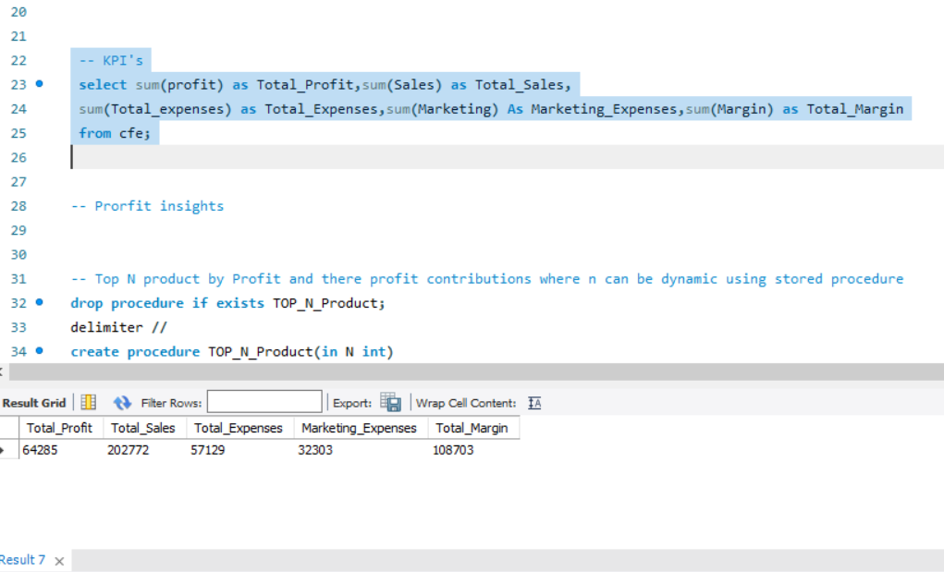
KPI’s
From this Sql Query we get the KPI’s

Slide 8
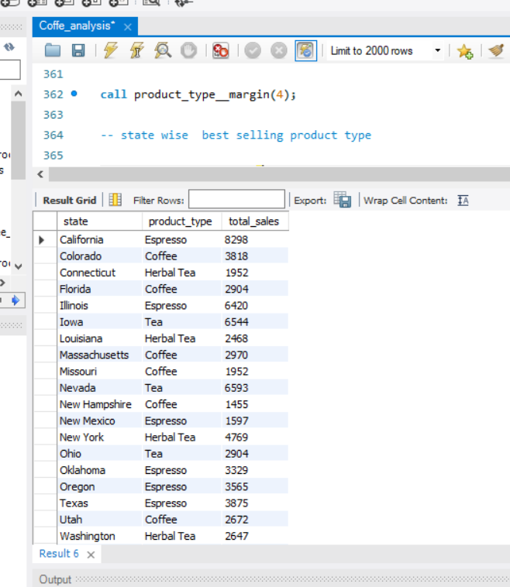
Insights
From this Sql query we get
The best selling product_type by state
We can easily identify what the product_type customers want in these states

Slide 9
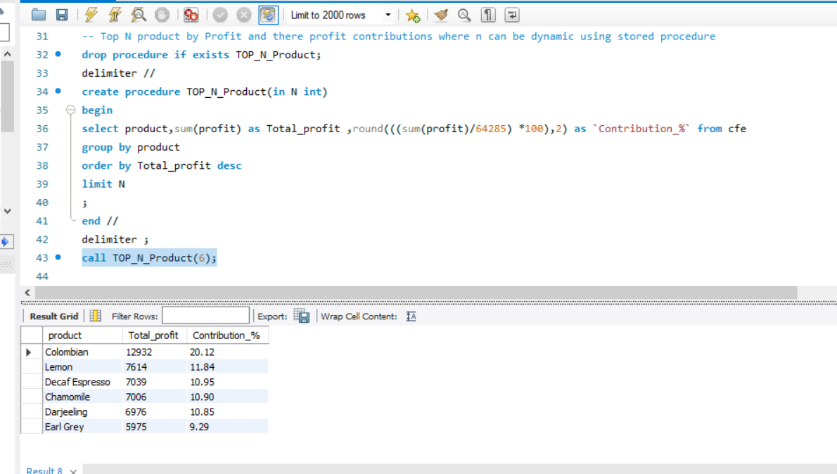
Insights
From this sql query we get
Top N product by Profit and there profit contributions using stored procedure

Slide 10
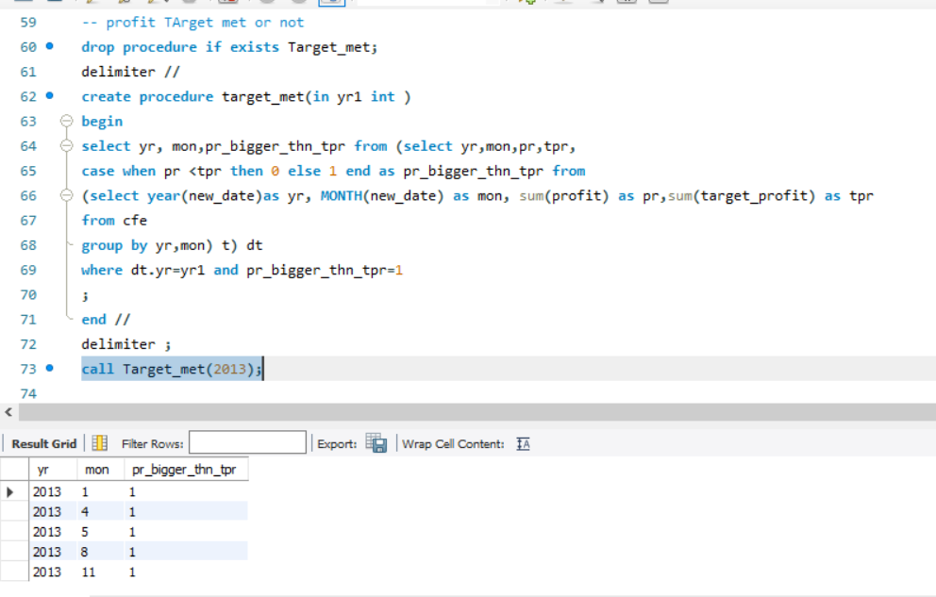
Insights
From this Sql Query we get
Where the profit is bigger than target profit and here Year is dynamic.

Slide 11
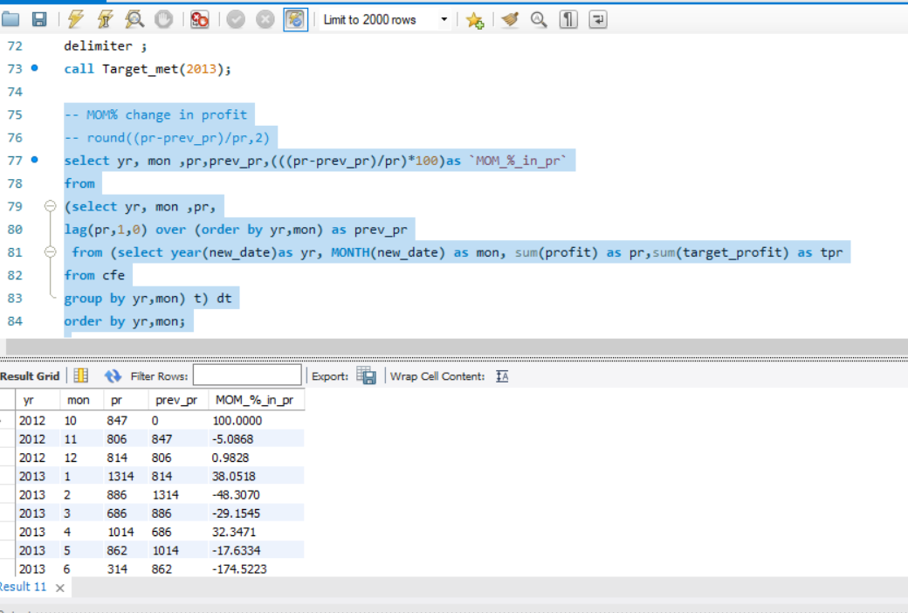
Insights
From this Sql Query we get
MOM% change in profit

Slide 12
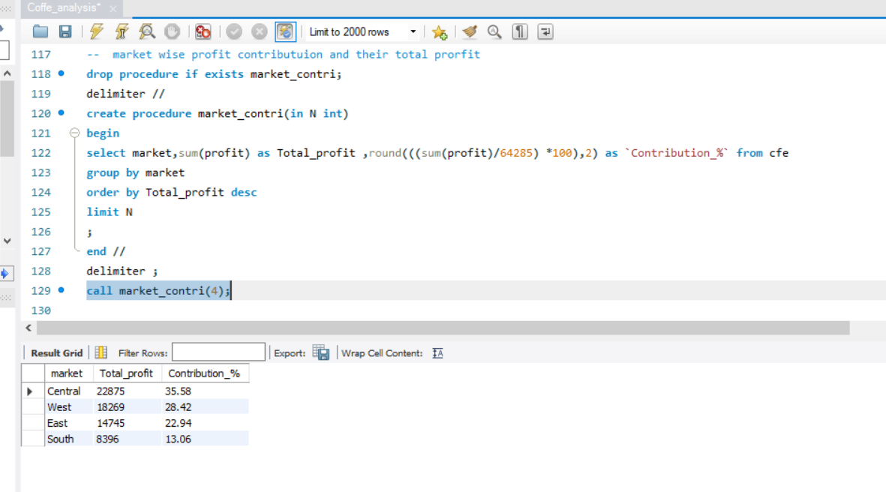
Insights
From this sql query
we get the contribution% and total profit generated by market categories

Slide 13
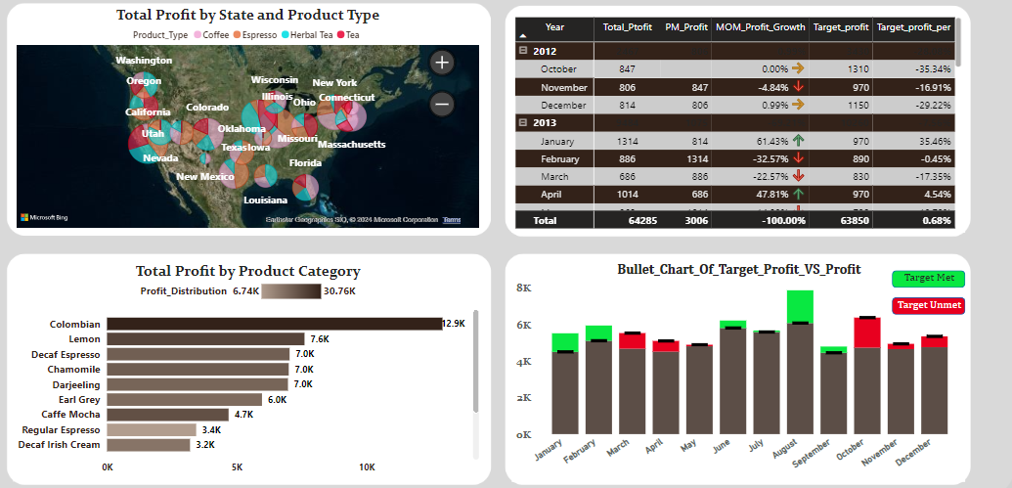
Insights
a
From these Charts we can find:-
Total profit by state and product type as a pie chart
Total profit by category
MOM% change in profit
Bullet charts where the target is met

Slide 14
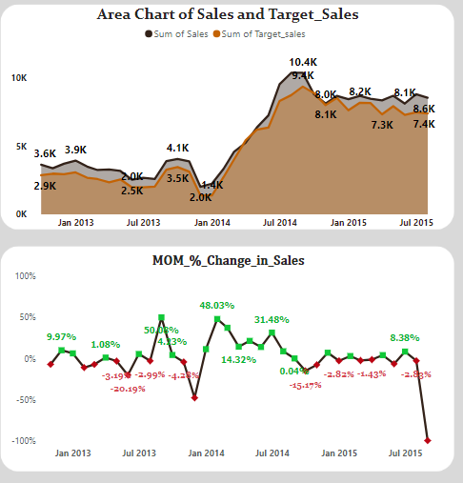
Insights
From these two charts we get:-
Where the area is overlapping of target sales and sales it means the target is not met
MOM% changes in sales
Redpoint show the decline in the sales where green point represent the incline of the sales

Slide 15
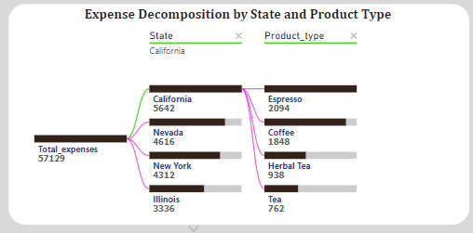
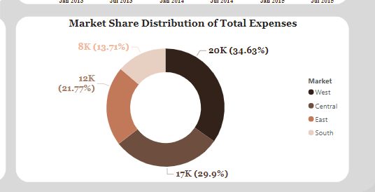
Insights
a
From these Charts we can find:-
From first chart we get a decomposition tree which we can find low and high expenses of state and product_type w.r.t to state
The second chart represent a donut chart which shows the Maket Share distribution of total expanses

Slide 16
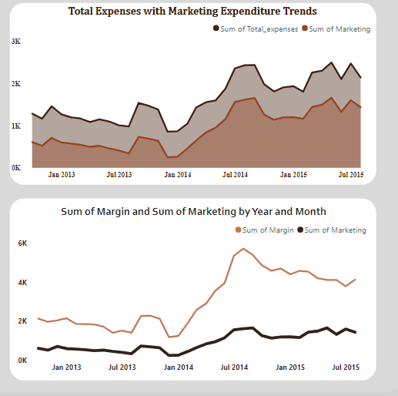
Insights
a
From these Charts we can find:-
From the first chart we can find if the marketing expenses increase then the total expanses also increases.
From the second chart we can find that if the marketing expenses increases then margin also increases.

Slide 17

Conclusion
Through coffee sales analysis using Power BI and Tableau, we've gained actionable insights:
Sales Performance: Identified top products, regions, and customer segments.
Trend Analysis: Examined sales trends over time, detecting seasonal patterns.
Consumer Insights: Uncovered preferences, behaviors, and buying patterns.
Market Competitiveness: Evaluated competition, positioning, and growth opportunities.
Benefits:
Data Visualization: Presented complex data intuitively.
Interactivity: Enabled exploration of insights.
Scalability: Managed large datasets efficiently.
Insight Generation: Facilitated quick and informed decision-making.
Next Steps:
Implementation: Translate findings into actionable strategies.
Monitoring: Regularly monitor metrics and market trends.
Further Analysis: Explore additional dimensions for new insights.
Thank You!

Slide 18


References
Dataset from Kaggle.com
Helps from friends and teachers
Power BI Documentation

Slide 19

Thank
You!

